Slide 1

Dr. Hesam Chiniforooshan
se.usc.ac.ir@gmail.com

Slide 2
Outline
An overview of non-agile software processes
Traditional SP
RUP
Agile Software Development
Agile Manifesto
Agile Principles
Agile methods
eXtreme Programming (XP)
Scrum

Slide 3
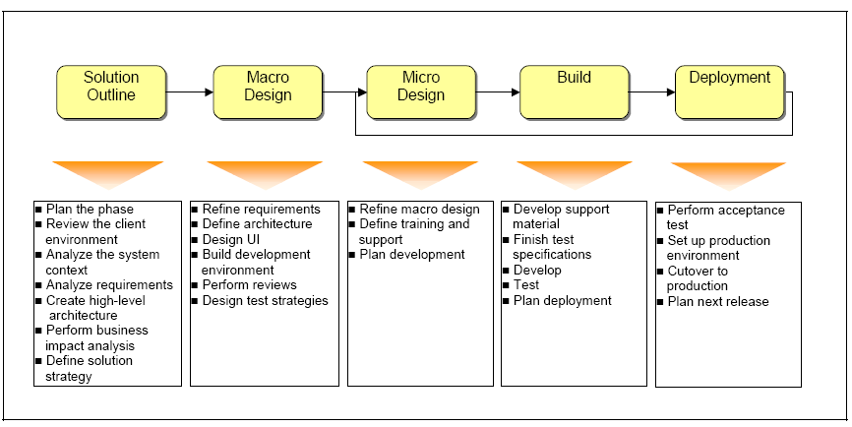
Traditional Software Development Process
Recognition that:
Highly defined process with predictable start and finish dates for tasks is unrealistic
Predictive, phased-project waterfall approach not working
Reality is:
Requirements change
SW development is intellectually intensive, creative process
Often developing in highly complex and uncertain domain
Requires empirical management & control process – inspect and adapt feedback loops
Peter Kutschera“ Applying Agile Methods in Rapidly Changing Environments” ,RTO IST Symposium on “Technology for Evolutionary Software Development”,

Slide 4
Traditional Software Development Process
4
Peter Kutschera“ Applying Agile Methods in Rapidly Changing Environments” ,RTO IST Symposium on “Technology for Evolutionary Software Development”,

Slide 5

Moving toward
Iterative & Incremental
Software Development Processes

Slide 6
Unified Process Lifecycle
Notes:
Inception - The idea for the project is stated. The development team determines if the project is worth pursuing and what resources will be needed.
Elaboration - The project's architecture and required resources are further evaluated. Developers consider possible applications of the software and costs associated with the development.
Construction - The project is developed and completed. The software is designed, written, and tested.
Transition - The software is released to the public. Final adjustments or updates are made based on feedback from end user

Slide 7
Unified Process
RUP
An instance of the Unified Process
The most famous heavyweight Process
Makes the most use of UML Diagrams
Business Modeling
Business Process Modeling
Requirements
Requirements Models (Use case Diagram, Glossaries)
Analysis and Design
Analysis Models (Class Diagram, Activity Diagram, State Diagram)
Design Models (Class Diagram, Activity Diagram, State Diagram, Architectural Model, Component Diagram, Composite Diagram)
The main problem with RUP is its slowness in reaching the code, due to high emphasis on documentation and modeling
In software development with RUP, the prescribed process is highly detailed and has significant important
Benefits ?
Drawbacks?

Slide 8
Moving toward
Lightweight
Software Development Processes

Slide 9
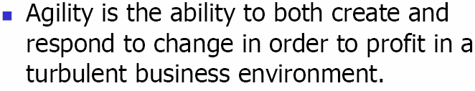
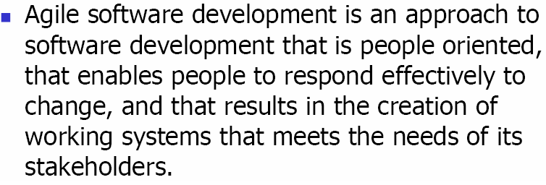
Agile Software Development
James h. Highsmiths, Agile Software Development Ecosystem

Slide 10
History of Agile
Incremental software development has been around since 1957.
In 1974, E. A. Edmonds wrote a paper that introduced an adaptive software development process.
The evolution of agile software development in the mid 1990s was a reaction to more heavyweight, document-driven methods (waterfall & RUP basically).
In February 2001, 17 developers met in Snowbird, Utah, to discuss lightweight software development and published the Agile Manifesto. This signaled industry acceptance of agile philosophy.

Slide 11
Agile Manifesto
Individuals and interactions over processes and tools
Working software over comprehensive documentation
Customer collaboration over contract negotiation
Responding to change over following a plan

Slide 12
Twelve Agile Principles
Our highest priority is to satisfy the customer through early and continuous delivery of valuable software.
Welcome changing requirements even late in development. Agile processes harness change for the customer's competitive advantage.
Deliver working software frequently, from a couple of weeks to a couple of months, with a preference to the shorter timescale.
Business people and developers must work together daily throughout the project.
Build projects around motivated individuals. Give them the environment and support they need, and trust them to get the job done

Slide 13
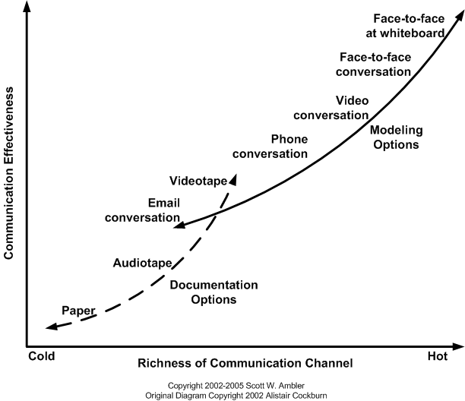
Twelve Agile Principles
The most efficient and effective method of conveying information to and within a development team is face-to-face conversation.
Try to follow the most effective communication technique applicable to your situation
Be prepared to change your approach throughout a project

Slide 14
Twelve Agile Principles
The most efficient and effective method of conveying information to and within a development team is face-to-face conversation.
Working software is the primary measure of progress.
Agile processes promote sustainable development. The sponsors, developers, and users should be able to maintain a constant pace indefinitely.
Continuous attention to technical excellence and good design enhances Agility.
Simplicity–the art of maximizing the amount of work not done – is essential.
The best architectures, requirements, and designs emerge from self-organizing teams.
At regular intervals, the team reflects on how to become more effective, then tunes and adjusts its behavior accordingly.

Slide 15
Who should / should not use Agile?
Agile home ground:
Low criticality
Senior developers ??
Requirements change often
Small number of developers
Culture that thrives on chaos
Plan-driven home ground:
High criticality
Junior developers ??
Requirements do not change often
Large number of developers
Culture that demands order
Formal methods:
Extreme criticality
Extreme quality
Senior developers
Limited requirements
limited features

Slide 16
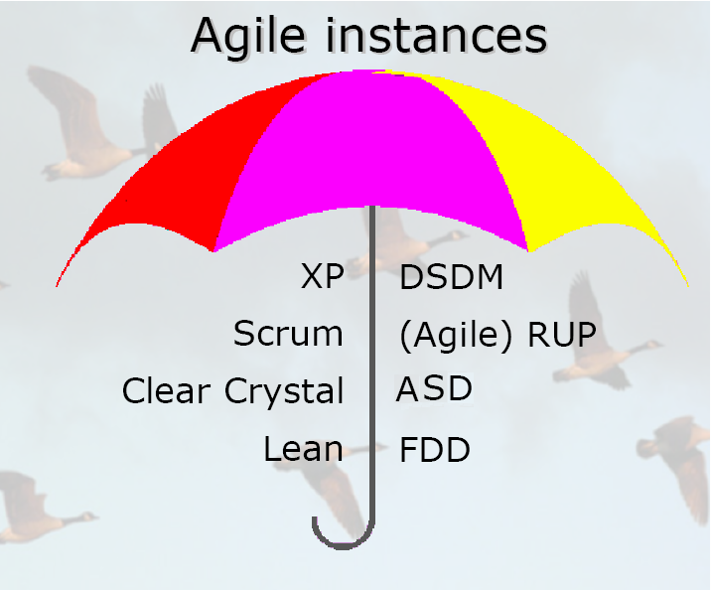
Agile Methodologies
Notes:
DSDM – Dynamic Systems Development Method
ASD – Adaptive Software Development
FDD – Feature Driven development

Slide 17
XP - eXtreme Programming
Developed by Beck in 1996. The first authentic XP book appeared in 1999, with a revised and refined version appearing in 2004.
Now, more than 20 books are available for XP
Although some of the methodologies that are nowadays dubbed as agile are older than XP, it was the advent of XP that sparked the agile movement.
Extreme Facts:
Improves software quality and responsiveness to changes
Short development cycles (time-boxing), less loss
Programming is done in pairs
Two people, one work station
Extensive testing
Unit Tests:
Take a given feature, write lots of tests for it
Every piece of code that is written is tested before continuing
Acceptance Tests:
Test your knowledge of the specifications made by the customer
“Testathon” – collaborative test writing
Avoids features until they are actually needed

Slide 18
XP Values
Communication
Rapidly building and disseminating institutional knowledge among members of a development team
The goal is to give all developers a shared view of the system which matches the view held by the users of the system
Simplicity
Extreme Programming encourages starting with the simplest solution. Extra functionality can then be added later.
“You ain't gonna need it”
Feedback
Feedback from the system: by writing unit test or running periodic integration tests
Feedback from the customer: The functional tests (aka acceptance tests) are written by the customer and the testers
Feedback from the team: planning game (for new ) and retrospectives
Courage
One is the commandment to always design and code for today and not for tomorrow [Refactoring will improve it]
knowing when to throw code away: courage to remove source code that is obsolete, no matter how much effort was used to create that source code
persistence: A programmer might be stuck on a complex problem for an entire day, then solve the problem quickly the next day, if only they are persistent.
Respect
For others as well as self-respect
never commit changes that break compilation, that make existing unit-tests fail, or that otherwise delay the work of their peers.
always striving for high quality and seeking for the best design for the solution at hand through refactoring

Slide 19
XP Practices
Fine scale feedback
Pair-programming -- all production code is written with two programmers at one machine
Planning game – determine scope of the next release by combining business priorities and technical estimates
Test-Driven Development – programmers continuously write unit tests; customers write tests for features
On-site customer – a user is on the team and available full-time to answer questions
Continuous process
Continuous integration – integrate and build the system many times a day – every time a task is completed.
Refactoring – programmers continuously restructure the system without changing its behavior to remove duplication and simplify
Small releases – put a simple system into production, then release new versions in very short cycle

Slide 20
XP Practices
Shared understanding
Coding standards – programmers write all code in accordance with rules emphasizing communication through the code
Collective ownership – anyone can change any code anywhere in the system at any time.
Simple design – system is designed as simply as possible (extra complexity removed as soon as found)
System Metaphor – all development is guided by a simple shared story of how the whole system works
Programmer welfare
40-hour week – work no more than 40 hours a week as a rule

Slide 21
XP Values
Communication
Rapidly building and disseminating institutional knowledge among members of a development team
The goal is to give all developers a shared view of the system which matches the view held by the users of the system
Simplicity
Extreme Programming encourages starting with the simplest solution. Extra functionality can then be added later.
“You ain't gonna need it”
Feedback
Feedback from the system: by writing unit tests or running periodic integration tests
Feedback from the customer: The functional tests (aka acceptance tests) are written by the customer and the testers
Feedback from the team: planning game (for new ) and retrospectives
Courage
One is the commandment to always design and code for today and not for tomorrow [Refactoring will improve it]
knowing when to throw code away: courage to remove source code that is obsolete, no matter how much effort was used to create that source code
persistence: A programmer might be stuck on a complex problem for an entire day, then solve the problem quickly the next day, if only they are persistent.
Respect
For others as well as self-respect
never commit changes that break compilation, that make existing unit-tests fail, or that otherwise delay the work of their peers.
always striving for high quality and seeking for the best design for the solution at hand through refactoring

Slide 22
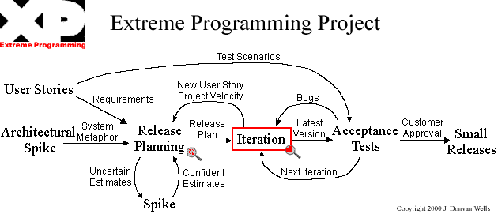
XP Process
User Story:
- As a <role>, I want <goal/desire> so that <benefit>
- As a <role>, I want <goal/desire>
* Should be written by the customers
* It is informal and does not contain technical details, also it represents WHAT, not HOW
* Should not be long (often in one to three sentences – fit on 3x5 inches cards )
* Before implementation every US should be completed by relevant Acceptance tests

Slide 23
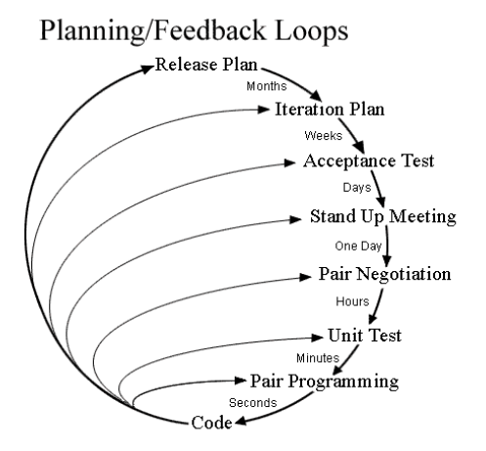
XP Values
Communication
Rapidly building and disseminating institutional knowledge among members of a development team
The goal is to give all developers a shared view of the system which matches the view held by the users of the system
Simplicity
Extreme Programming encourages starting with the simplest solution. Extra functionality can then be added later.
“You ain't gonna need it”
Feedback
Feedback from the system: by writing unit tesrt or running periodic integration tests
Feedback from the customer: The functional tests (aka acceptance tests) are written by the customer and the testers
Feedback from the team: planning game (for new ) and retrospectives
Courage
One is the commandment to always design and code for today and not for tomorrow [Refactoring will improve it]
knowing when to throw code away: courage to remove source code that is obsolete, no matter how much effort was used to create that source code
persistence: A programmer might be stuck on a complex problem for an entire day, then solve the problem quickly the next day, if only they are persistent.
Respect
For others as well as self-respect
never commit changes that break compilation, that make existing unit-tests fail, or that otherwise delay the work of their peers.
always striving for high quality and seeking for the best design for the solution at hand through refactoring

Slide 24
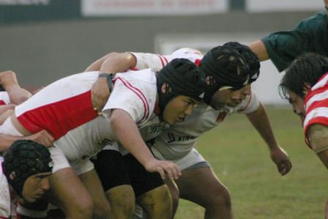
Scrum
"tries to go the distance as a unit, passing the ball back and forth"

Slide 25
Scrum
Iterative, incremental methodology
Roles in Scrum:
ScrumMaster
Maintains the process, enforces the rules
Remove development obstacles
SM is NOT the leader of team
Facilitates communications
“The Scrum Master is responsible for the success of the project, and he or she helps increase the probability of success by helping the Product Owner select the most valuable product backlog and by helping the Team turn that backlog into functionality.”
Product Owner
Represents the customer
Who this program is for/who's paying for this
Is responsible for ROI
Prioritization of requirements
“The Product Owner directs the project, Sprint by Sprint, to provide the greatest ROI and value to the organization.”
Team
A group of about 7 people who do the actual work (analysis, design, code, test, ….)
Self-Organizing
Cross-functional individuals
“The Team is responsible for managing itself and has the full authority to do anything to meet the Sprint goal within the guidelines, standards, and conventions of the organization and of Scrum.”

Slide 26
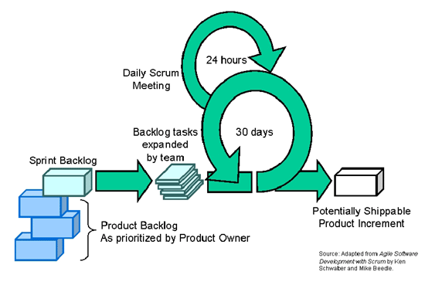
Scrum Process
Time-Boxed vs Activity-Based Planning
TB: The project is decomposed into fixed-length time boxes, within which development activities are performed
AB: The project is decomposed into a set of activities which their completion represent a Milestones of the project
Scrum realized time-boxed development through Sprints, which are 2-4 weeks
26
Notes:
26

Slide 27
Scrum Process
Time-Boxed vs Activity-Based Planning
TB: The project is decomposed into fixed-length time boxes, within which development activities are performed
AB: The project is decomposed into a set of activities which their completion represent a Milestones of the project
Scrum realized time-boxed development through Sprints, which are 2-4 weeks

Slide 28
Scrum Practices
The Sprint Planning Meeting
Is attended by the Product Owner, Scrum Master, the entire Scrum Team, also any interested and appropriate management or customer representatives
Product Owner describes highest priority features to the Team
The Product Owner selects the ideal backlog for the coming Sprint and communicates its meaning and importance to the team.
Team asks questions for clarification of PB items
Collectively, the Scrum team and the product owner define a sprint goal
A short description of what the sprint will attempt to achieve.
The success of the sprint will later be assessed during theSprint Review Meeting against the sprint goal, rather than against each specific item selected from the product backlog.
Team decides (separately) what the can commit to delivering in the Sprint
The Team decides how much it can commit to delivering in the coming Sprint.
The Product Owner answers questions but does not direct the team’s choices.
The outcome is the Sprint Backlog

Slide 29
Scrum Practices
The Sprint Review Meeting
At the end of each sprint a sprint review meeting is held. (2 hours)
Team demonstrates product increment to product owner: A demo of the new features
Informality is encouraged. PowerPoint is discouraged.
A sprint review meeting should not become a distraction or significant detour for the team; rather, it should be a natural result of the sprint.
During the sprint review the project is assessed against the sprint goal determined during the Sprint planning meeting.
Ideally the team has completed each product backlog item brought into the sprint,
But it is more important that they achieve the overall goal of the sprint.
The Sprint Retrospective
Time boxed to three hours, at the end of each Sprint
Team, Scrum Master, and (optionally) Product Owner review the last Sprint
What went well?
What can be improved?

Slide 30
Scrum Practices
The Daily Scrum
Time boxed to fifteen minutes! EVERY DAY
The Team and the Scrum Master (PO is also good to attend)
is not used as a problem-solving or issue resolution meeting.
Issues that are raised are taken offline and usually dealt with by the relevant sub-group immediately after the daily scrum
member provides answers to the following three questions
What have you accomplished since yesterday?
What are you working on today?
Are there any impediments in your way?
The daily scrum is not a status update meeting in which a boss is collecting information about who is behind schedule
Rather, it is a meeting in which team members make commitments to each other.
Sample Impediments:
My ____ broke and I need a new one today.
I still haven't got the software I ordered a month ago.
I need help debugging a problem with ______.
I'm struggling to learn ______ and would like to pair with someone on it.
I can't get the vendor's tech support group to call me back.
Our new contractor can't start because no one is here to sign her contract.
I can't get the ____ group to give me any time and I need to meet with them.
The department VP has asked me to work on something else "for a day or two."

Slide 31
Scrum Artifacts
The Product Backlog
The Product Backlog is the master list of all functionalities desired in the product
It is NOT necessary to start a project with a lengthy, upfront effort to document all requirements.
Product backlog items can be technical tasks ("Refactor the Login class to throw an exception") or more user-centric (“Withdraw money from my bank account").
XP User Stories is a good approach to fill the Product Backlog
Product Owner writes and prioritize the product backlog
Scrum master can update it along the sprints
Sample Product Backlog (based on XP User Stories)
As a user, I want to reserve a hotel room
As a user, I want to cancel a reservation
As a vacation planner, I want to see photos of the hotels
As a frequent flier, I want to rebook a past trip, so that I save time booking Trips

Slide 32
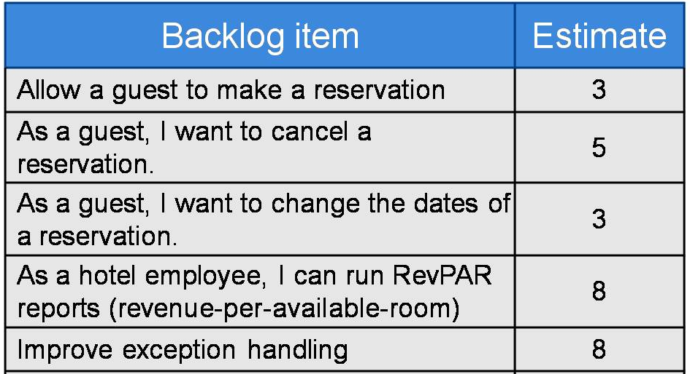
Sample Product Backlog

Slide 33
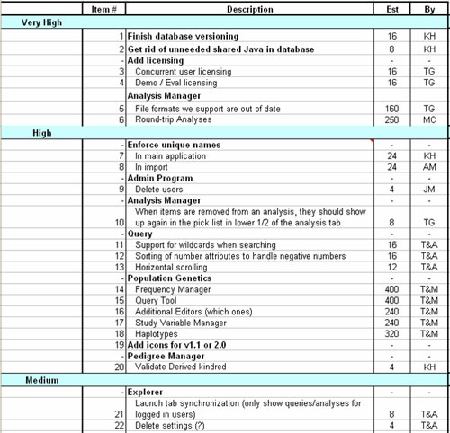
Sample Product Backlog
Estimates have been developed by the developers but it is understood that they are very imprecise and are useful only for rough assignments of tasks into the various sprints.
- Point Estimation
- Time Estimation

Slide 34
Scrum Artifacts
The Sprint Backlog
The list of tasks that the Scrum team is committing that they will complete in the current sprint.
Items on the sprint backlog are drawn from the Product Backlog, and Detailed into smaller list of things needed to be done
Selected based on the priority of in the product backlog
Due by next sprint !!
Sample Sprint Backlog
As a user, I want to reserve a hotel room
Add hotel table to the database – 1 hr
Write Ajax code to display reservation – 4 hrs
Write code to enter reservation in the database – 4 hrs
As a user, I want to cancel a reservation
Display the user’s current reservations – 4 hrs
Add a cancel button next to each reservation – 1 hr

Slide 35
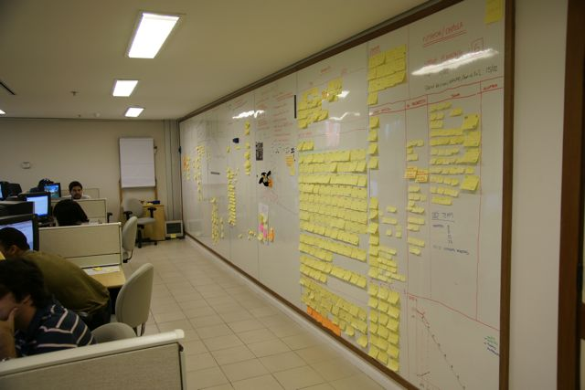
Sample Sprint Backlog

Slide 36
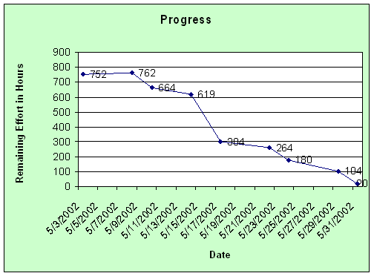
Scrum Artifacts
The Sprint Burndown Chart
Shows the project progress on a daily basis
During the Sprint the ScrumMaster maintains the sprint backlog by updating it to reflect which tasks are completed and how long the team thinks it will take to complete those that are not yet done. The estimated work remaining in the sprint is calculated daily and graphed, resulting in a sprint burndown chart like this one:

Slide 37
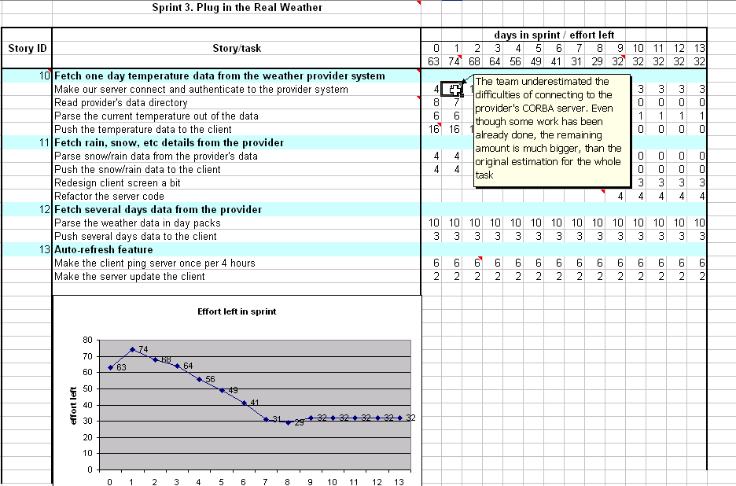
Sample Sprint Backlog / S. Burndown Chart

Slide 38
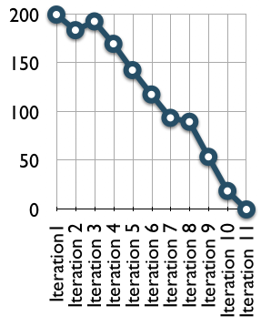
Scrum Artifacts
Release Burndown Chart
The team tracks its progress against a release plan by updating a release burndown chart at the end of each sprint.
The horizontal axis of the release burndown chart shows the sprints;
The vertical axis shows the amount of work remaining at the start of each sprint.

Slide 39
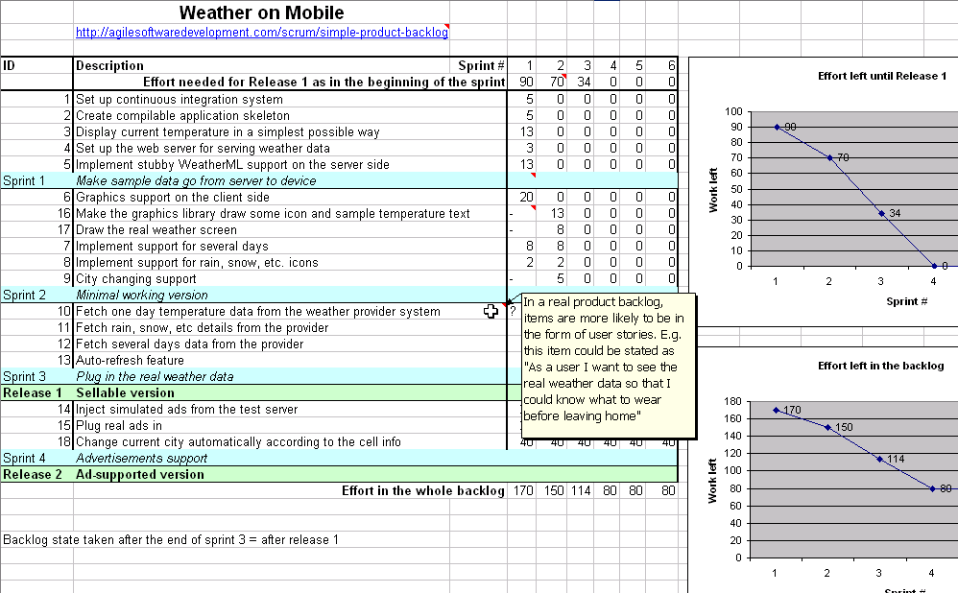
Sample Product Backlog / R. Burndown Chart

Slide 40
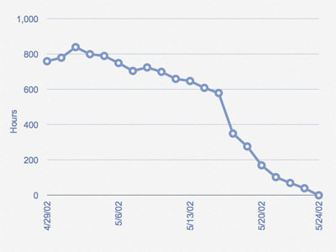
Adjusting the Sprint Backlog
The team does its best to pull the right amount of work into the sprint
But sometimes too much or too little work is pulled in during the Sprint planning meeting.
In this case the team needs to add or remove tasks.
In the above sprint burndown chart you can see that the team had pulled in too much work initially and still had nearly 600 hours to go on 5/16/02. In this case the Product Owner was consulted and it was agreed to remove some work from the sprint, which resulted in the big drop on the chart between 5/16/02 (619 hours) and 5/17/02. From there the team made good consistent progress and finished the sprint successfully.

Slide 41
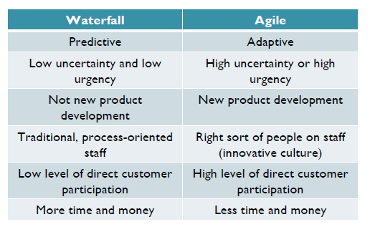
Agile vs Waterfall

Slide 42
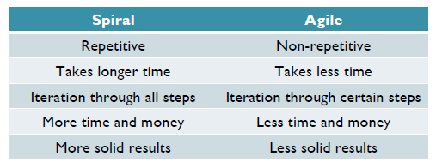
Agile vs Spiral

Slide 43
Does it work for us?

Slide 44
References
An Introduction to Agile Software Development: http://www.agilealliance.org
http://agilemanifesto.org/
http://www.mountaingoatsoftware.com/scrum/overview

